Slide 1

Effects of Mental Health Incidence on Crime
Spatial and Temporal Factors
in Chicago
Data Scientists
Connor Phillips, Hye Lee, Rob Golder (alphabetical order of first name)
Img src :http://www.shutterstock.com/video/search/crime/

Slide 2
Agenda
-Problem Statement
-Explain data collection, what does our data contain/what does it mean
-Exploring the Data
-Regression - predicting crime based on MH factors
-Time Series Analysis
-Conclusions

Slide 3
Problem Statement
Starting point: The Cook County Jail, which serves as the primary pretrial detention facility for arrestees in Chicago, is also one of the largest psychiatric treatment centers in the U.S.
In 2019, the City of Chicago released a new Framework for Mental Health Equity, investing millions of dollars each year to improve access to treatment.
We are exploring the relationships between mental health incidence and crime in the City of Chicago, with a particular emphasis on these relationships on a neighborhood by neighborhood basis.

Slide 4
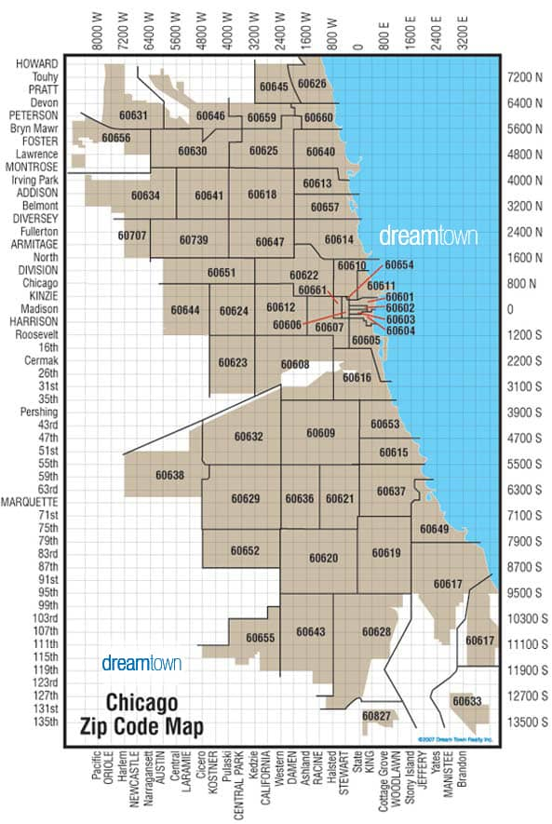
Visualizing Chicago
Chicago is organized into 77 different
neighborhoods. Data for crime and mental health is often collected by neighborhood, zip code, or even census tract. One of our challenges was on catenating data organized on these disparate levels.

Slide 5
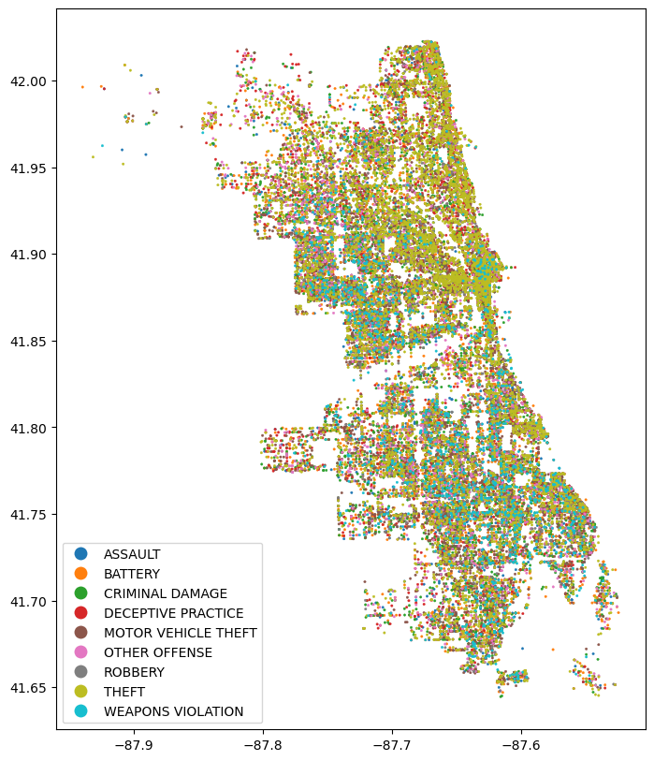
Crime Data by Area

Slide 6
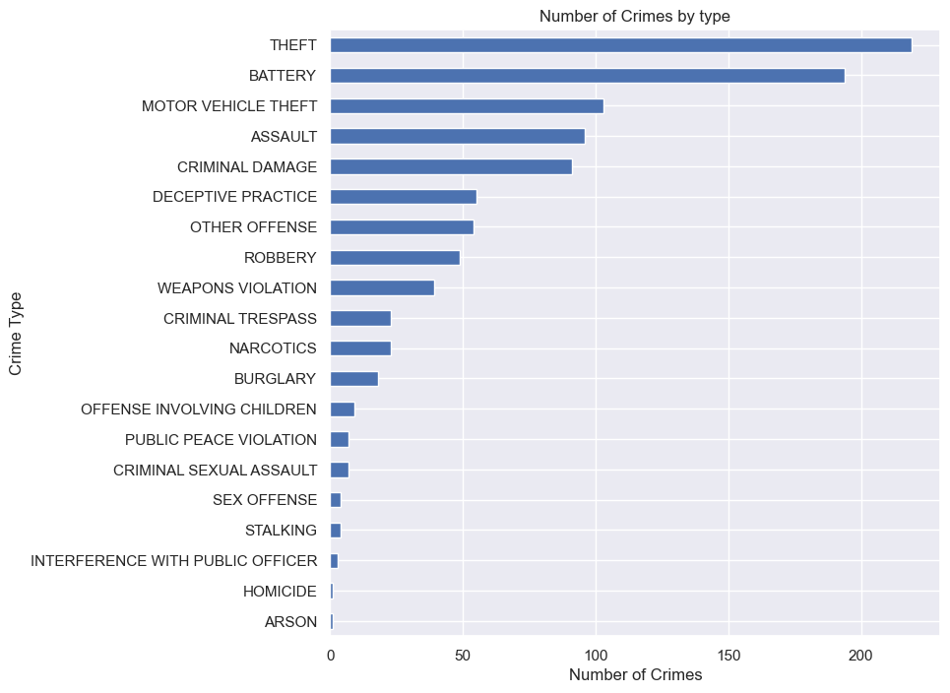
Crimes by Crime Type
The most occurred crimes were theft, battery, motor vehicle theft, assault, and criminal damage which is about 70% of all the crimes reported.

Slide 7
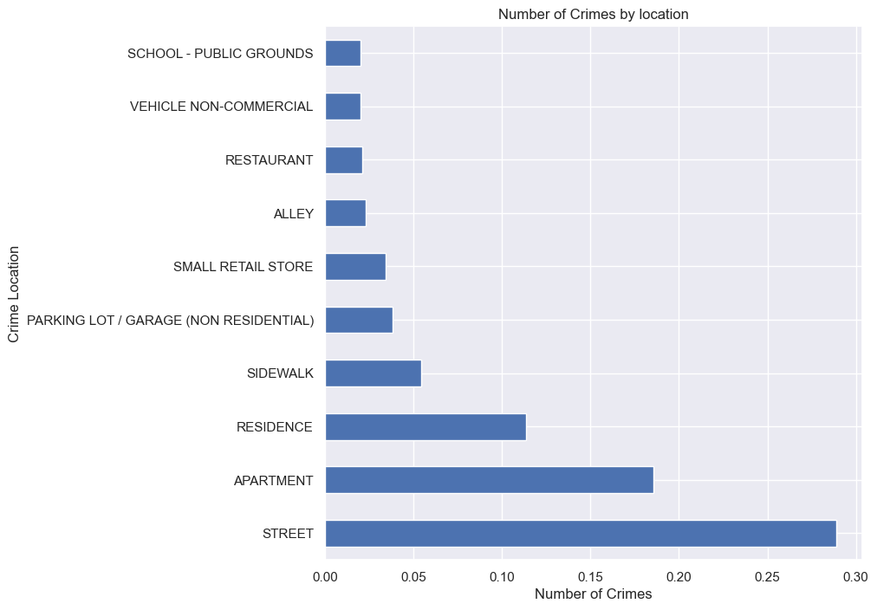
Crimes by Location
The most common locations to occur the crimes are at street, apartment, sidewalks, residence, where people are ordinarily at.

Slide 8
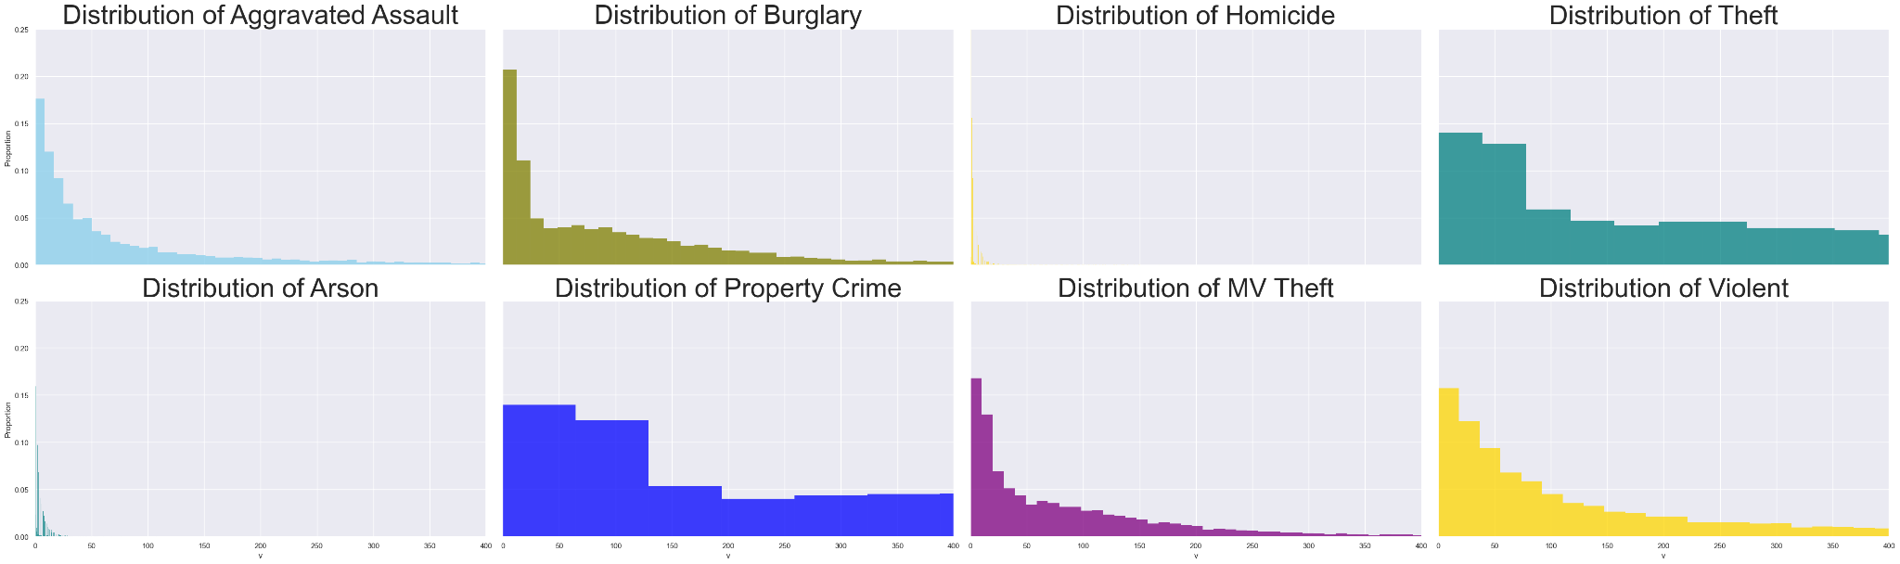
Crime Data by Neighborhoods: Raw

Slide 9
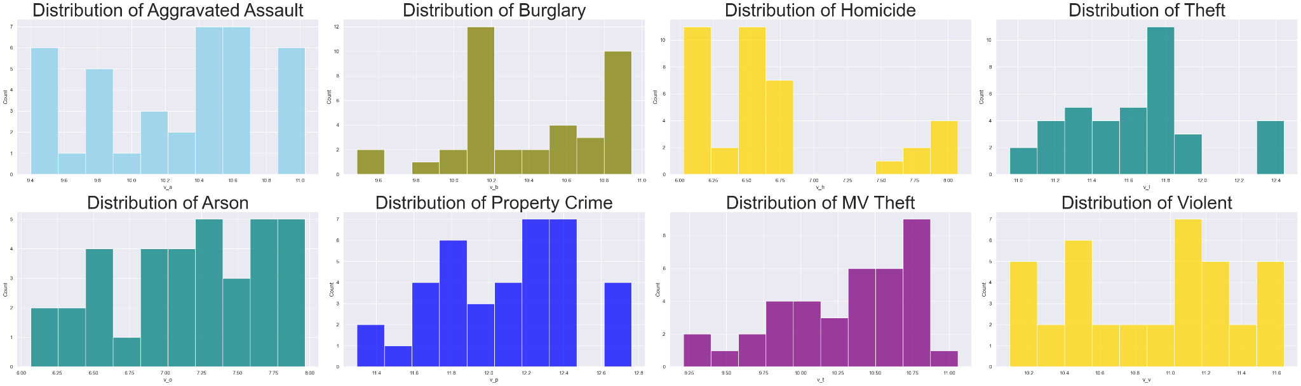
Crime Data by Neighborhoods: Log-transformed

Slide 10
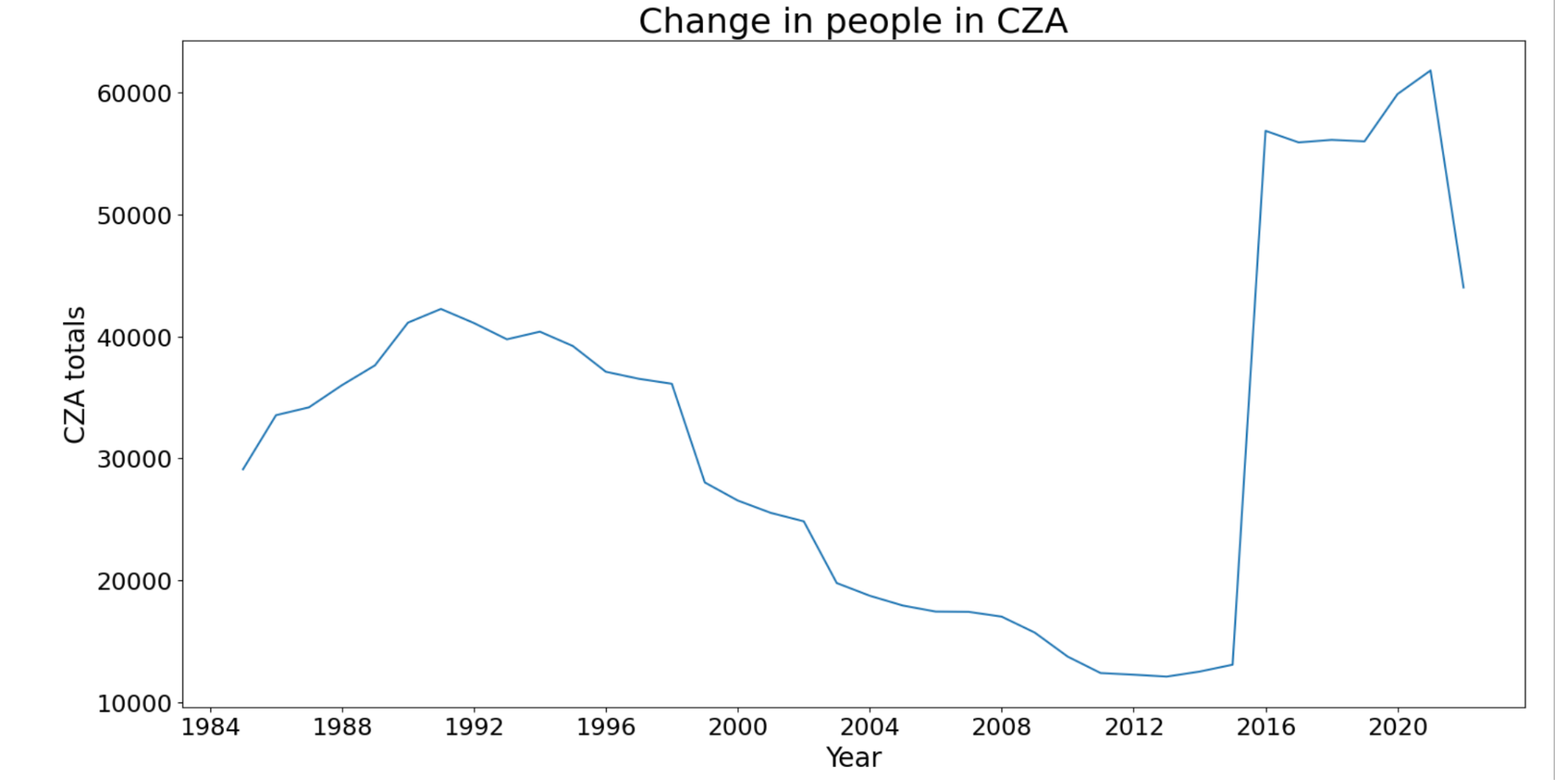
Time Series Analysis of Crime in Chicago
-Of twelve types, eight have been operating since 1985
-Totals for each year since then were compiled
-Due to skews in our EDA, decided to log
transform the data

Slide 11
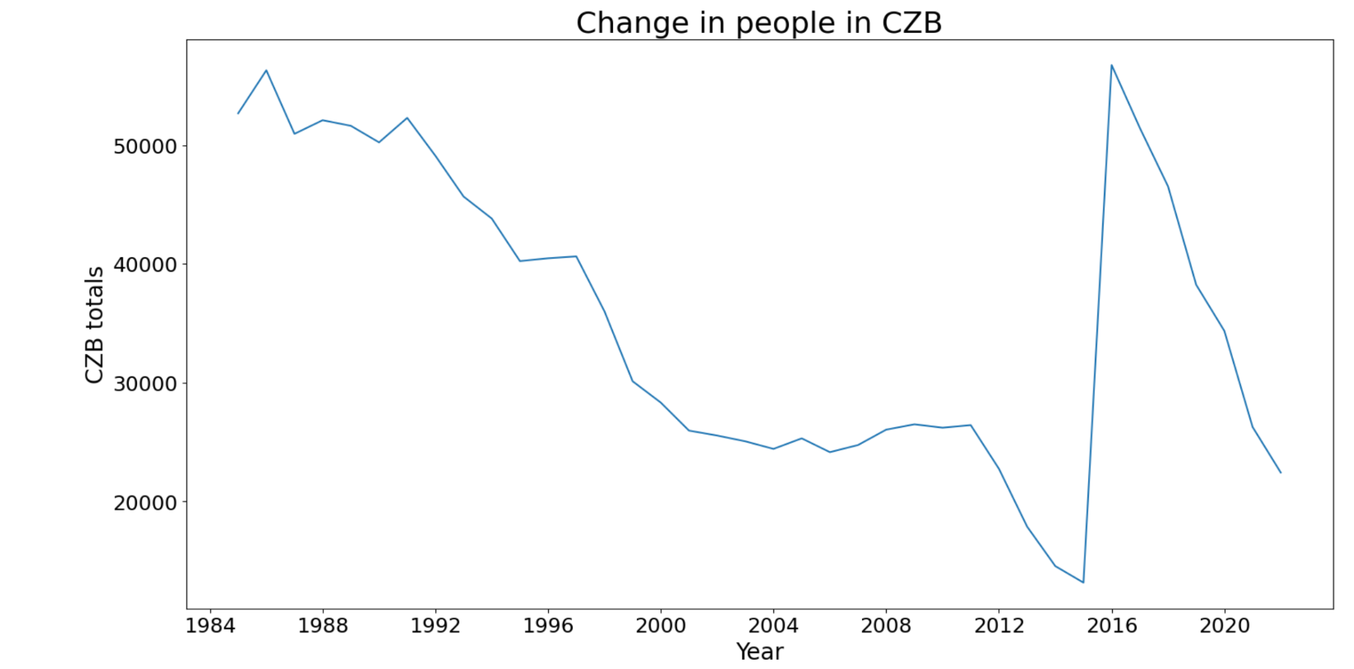
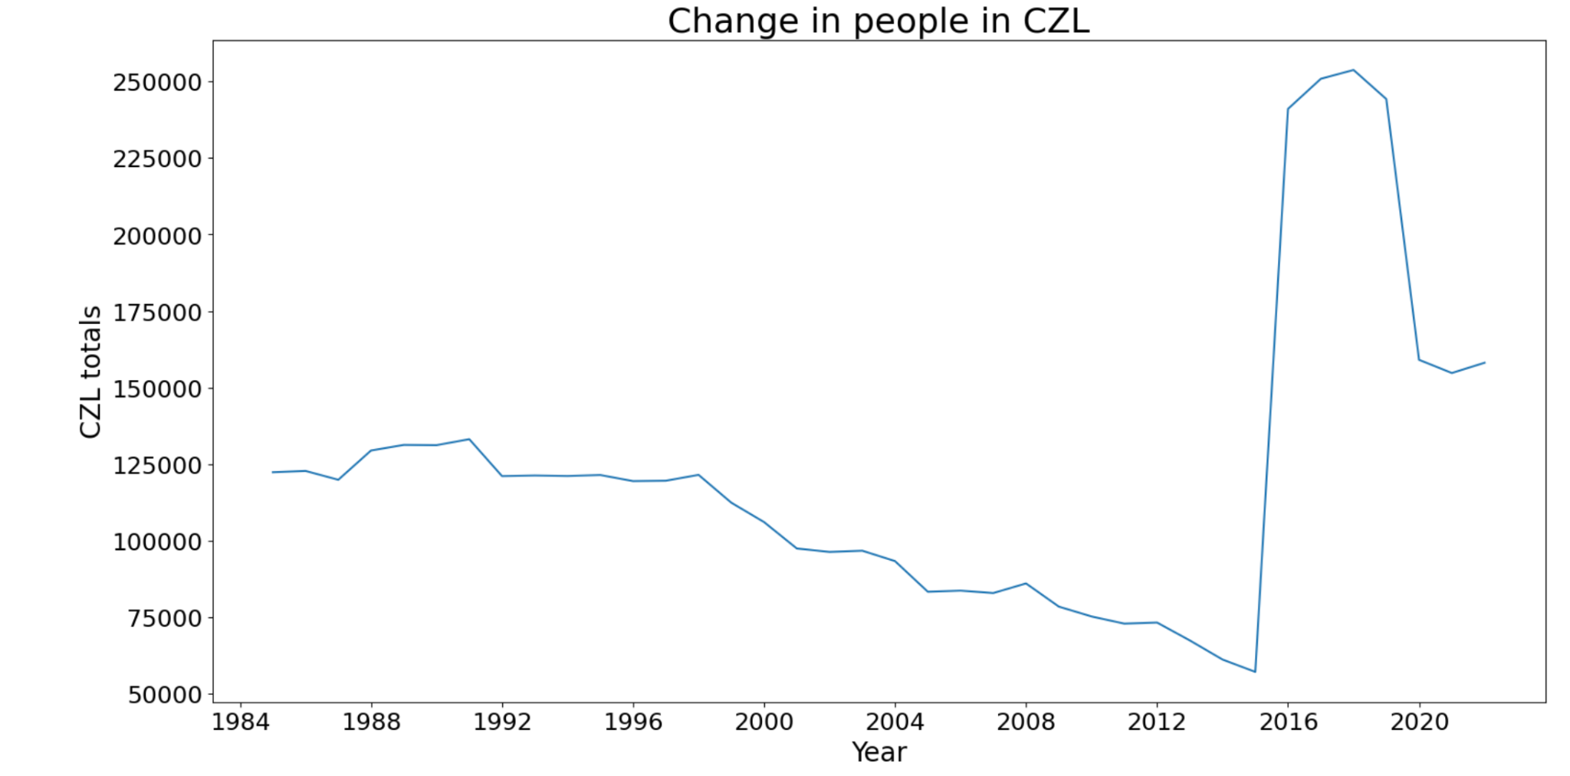
Time Series Visualized

Slide 12
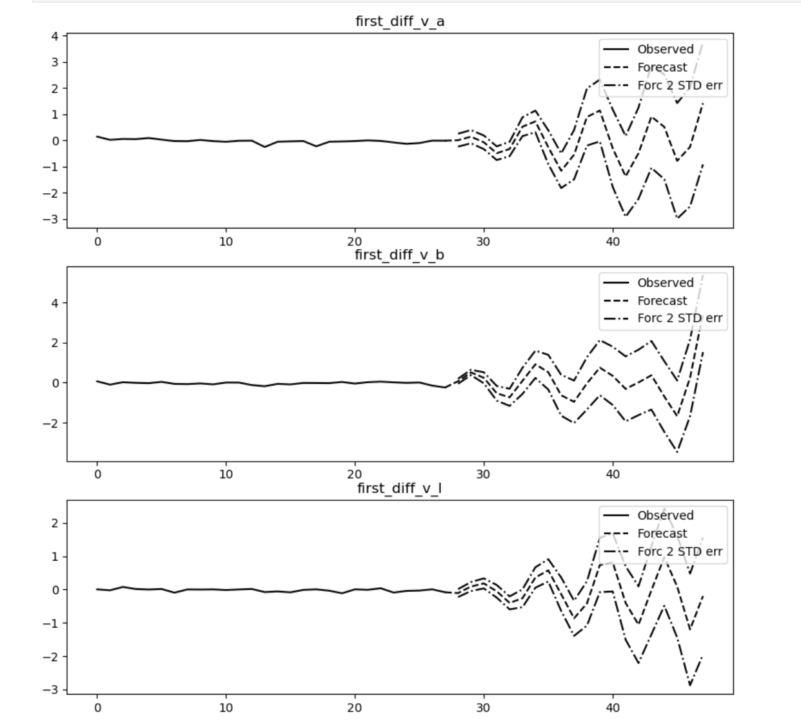
VAR Modeling
Forecasted 20 Years Into The Future
Best Model - CZA, CZB, CZL all differenced once
AIC -> -17.6479
Individual mean squared error -
CZA 1st Diff - 0.465232
CZB 1st Diff - 0.500432
CZL 1st Diff - 0.315641

Slide 13
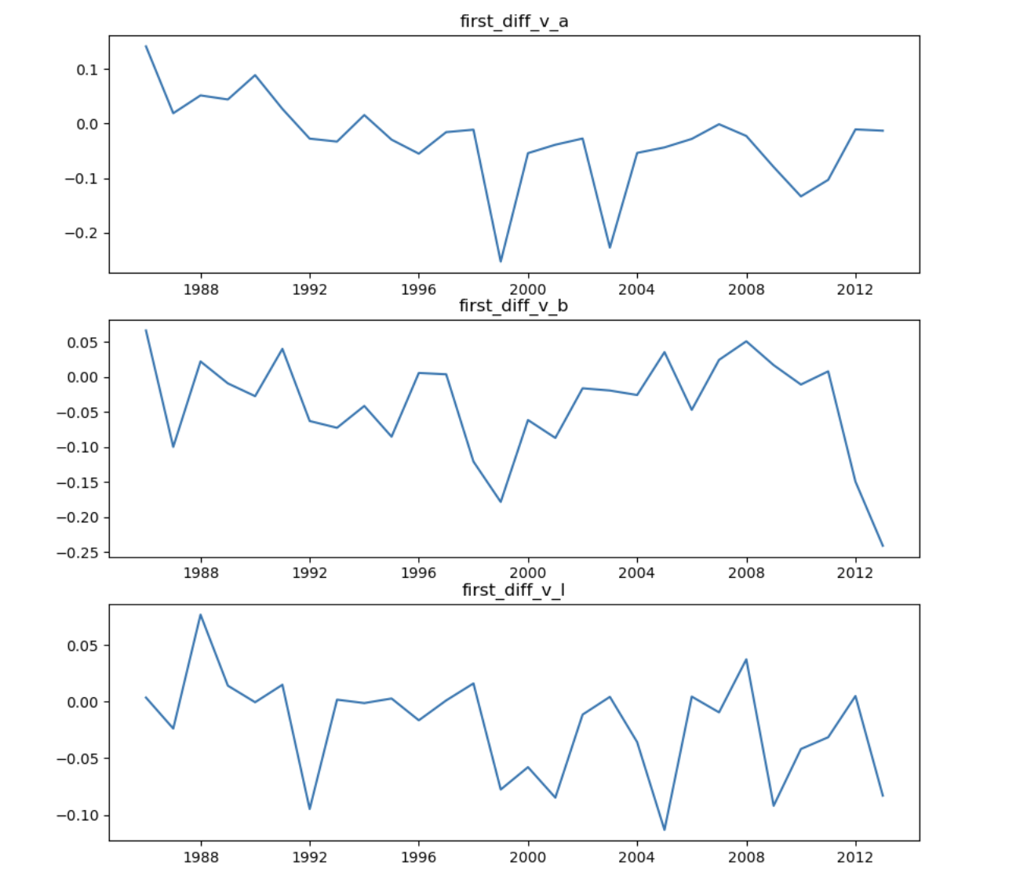
VAR Modeling Only Health Programs
AIC - Slightly better at -16.69
- Not enough temporal data

Slide 14
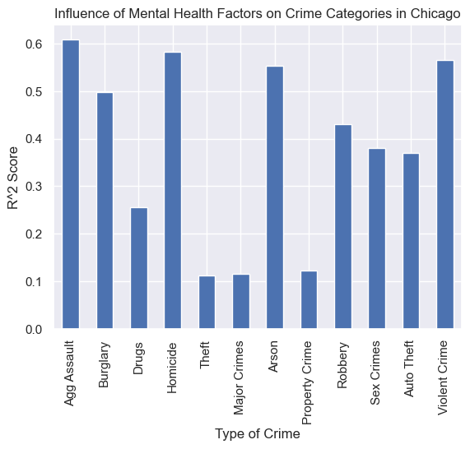
Influence of Mental Health Factors on Crime
Lasso Model
(alpha = 0.01)

Slide 15
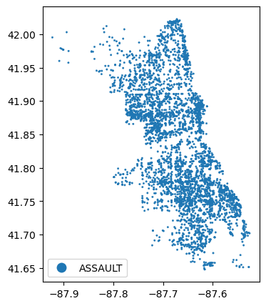
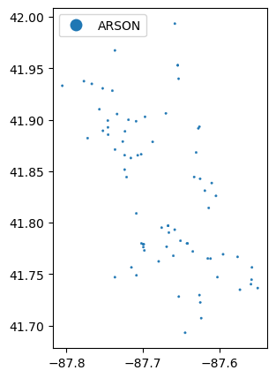
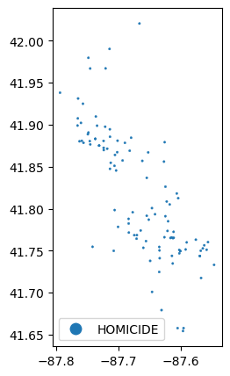
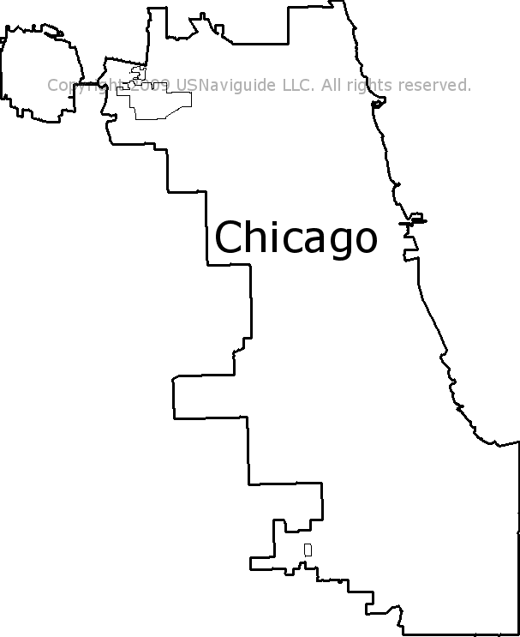
Mental Health-Influenced Crimes by Area

Slide 16
Conclusions
-Mental health incidents are more highly correlated with crimes that are more violent in nature:
High violence: Homicide, Arson, Agg Assault
Med violence: Burglary, Robbery, Drugs
Low violence: Theft, Auto Theft, Property
-Recommend interrupted time series analysis on the data, based on dramatic spike around 2016

Slide 17
Citations
Chicago Health Atlas
City of Chicago Data (data.cityofchicago.org)
Images: https://www.dreamtown.com/assets/img/maps/chicago-zipcode-map.jpg

